Slide 1
Sparse arrays
A matrix is sparse if many of its elements are zero
A matrix that is not sparse is dense
The boundary is not precisely defined
Diagonal and tridiagonal matrices are sparse
We classify triangular matrices as dense
Two possible representations
Array
Linked list

Slide 2
Array Representation of Sparse Matrix
The nonzero entries may be mapped into a 1D array in row-major order
To reconstruct the matrix structure, need to record the row and column each nonzero comes from

Slide 3
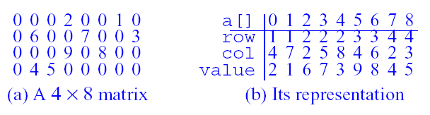

Slide 4
Linked Representation of Sparse Matrix
A shortcoming of the1-Darray of a sparse matrix is that we need to know the number of nonzero terms in each of the sparse matrices when the array is created
A linked representation can overcome this shortcoming

Slide 5
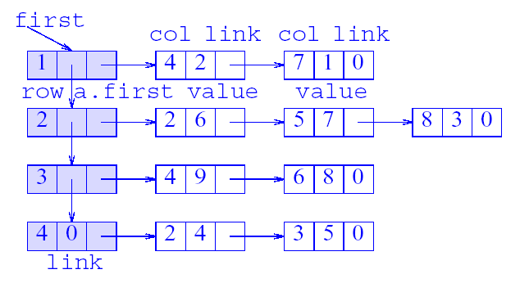

Slide 6
Operations on Sparse Matrix
Addition
Subtraction
Multiply
Transpose

Slide 7
Definition and Overview of Stacks
What is a stack?
Stores a set of elements in a particular order
Stack principle: LAST IN FIRST OUT = LIFO
It means: the last element inserted is the first one to be removed

Slide 8

Example
Which is the first element to pick up?

Slide 9
Last In First Out
A
B A
C B A
D C B A
E D C B A
D C B A
top
top
top
top
top

Slide 10
Stack Applications
Real life
a) Pile of books
b) Plate trays
More applications related to computer science a) Computer systems use stacks during a program’s execution to store function return addresses, local variables, etc.
b) Some calculators use stacks for performing mathematical operations. (evaluating expressions)

Slide 11
Static and Dynamic Stacks
Static Stacks
a) Fixed size
b) Can be implemented with an array
Dynamic Stacks
a) Grow in size as needed
b) Can be implemented with a linked list

Slide 12
Stack Operations
Push
causes a value to be stored in (pushed onto) the stack
Pop
retrieves and removes a value from the stack

Slide 13
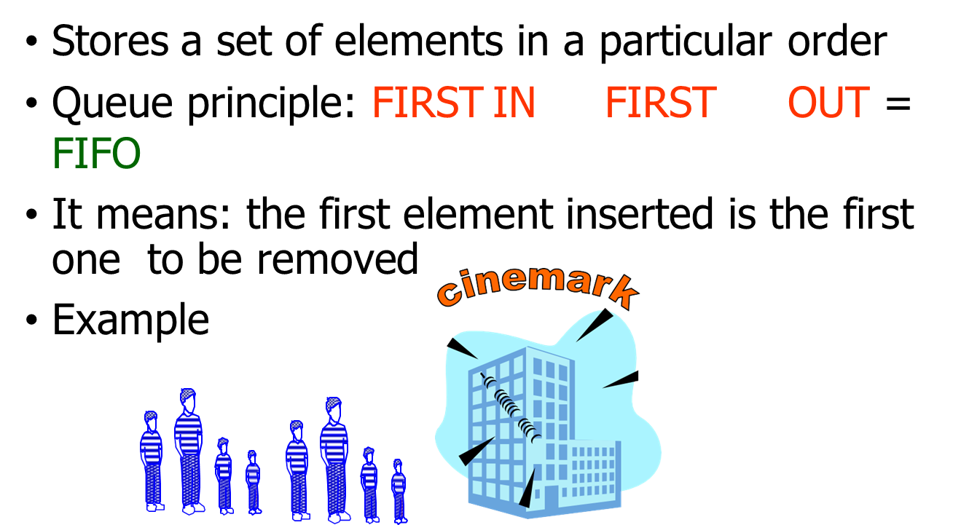
Queues

Slide 14
Queue Applications
Real life examples
1) Waiting in line 2) Waiting on hold for tech support
Applications related to Computer Science
1)Threads
2)Job scheduling (e.g. Round-Robin algorithm for CPU allocation)
3) In a multi-user system, a queue is used to hold print jobs submitted by users , while the printer services those jobs one at a time.

Slide 15
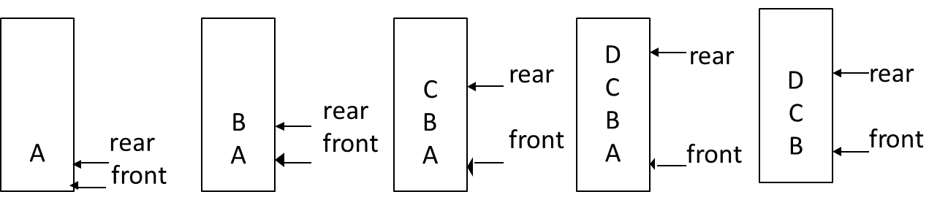
First In First Out

Slide 16
Static and Dynamic Queues
Just as stacks are implemented as arrays or linked lists, so are queues.
Dynamic queues offer the same advantages over static queues that dynamic stacks offer over static stacks.

Slide 17
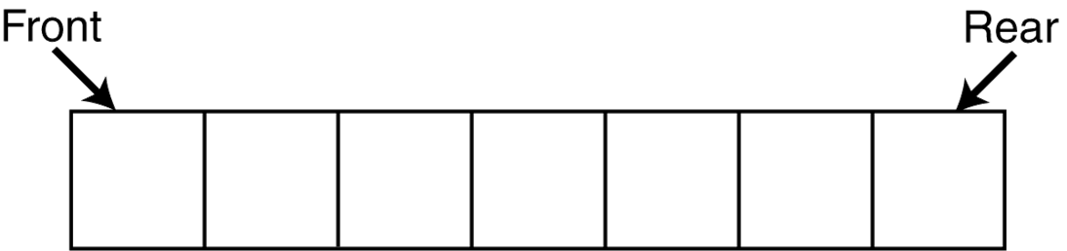
Queue Operations
Think of queues as having a front and a rear.

Slide 18
Queue Operations
The two primary queue operations are enqueuing and dequeuing.
To enqueue means to insert an element at the rear of a queue.
•To dequeue means to remove an element from the front of a queue.

Slide 19
Linked List

Slide 20
What is Linked List

Slide 21
Linked List Types
Singly Linked list
Circular singly linked list
Doubly linked lists
Circular doubly linked lists

Slide 22
Stacks-Implementation using Arrays
Allocate an array of some size (pre-defined) Maximum N elements in stack
Bottom stack element stored at element 0
last index in the array is the top
Increment top when one element is pushed, decrement after pop

Slide 23
The Push Operation
Suppose we have an empty integer stack that is capable of holding a maximum of three values. With that stack we execute the following push operations.
push(5);
push(10);
push(15);

Slide 24
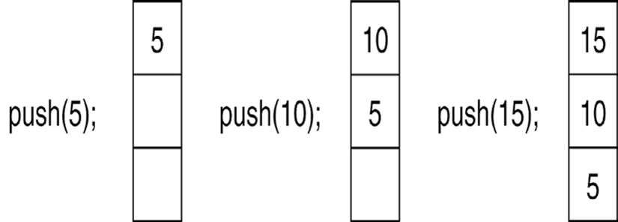
The Push Operation
The state of the stack after each of the push operations:

Slide 25
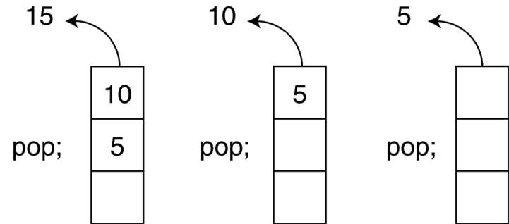
The Pop Operation
Now, suppose we execute three consecutive pop operations on the same stack:

Slide 26
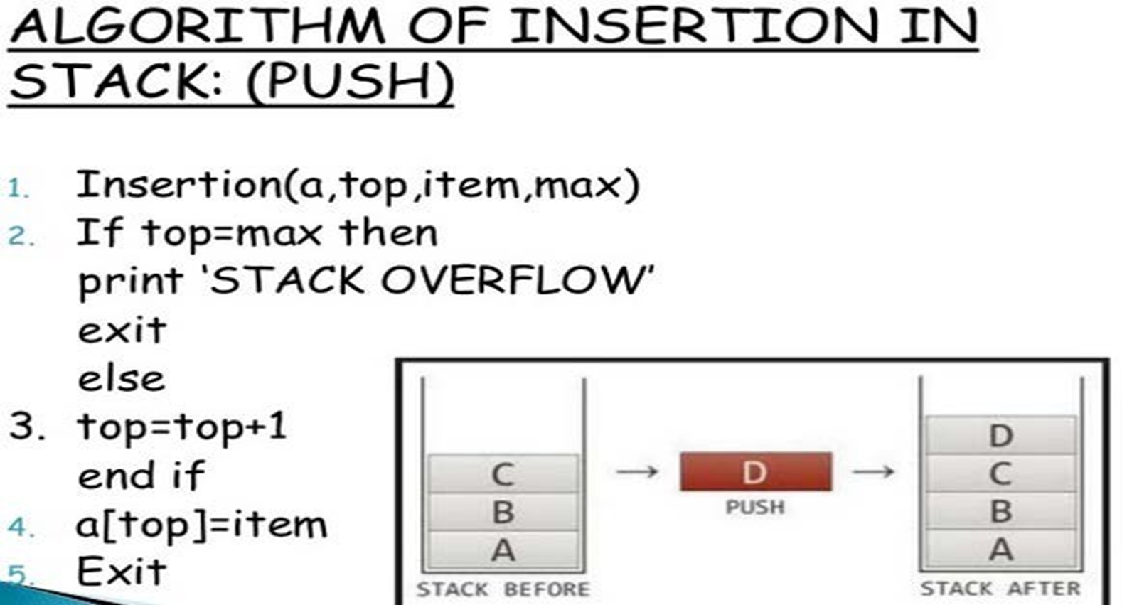

Slide 27
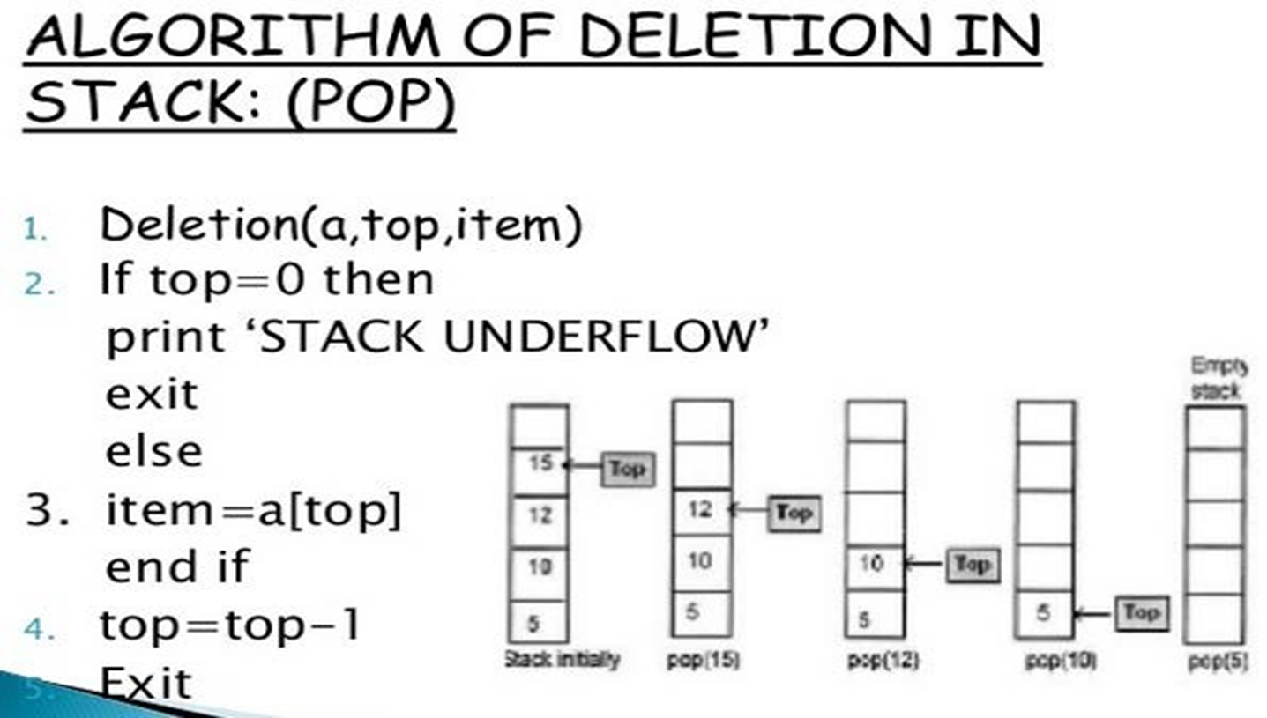

Slide 28
